Slide 1
Living with 21st century technology quiz
Summer School UNSW 2019: Research Lab 7
Jennifer Sloane

Slide 2
Confronting the greatest issues facing humanity
Researchers crossing disciplines to develop solutions to very complex issues
CLIMATE CHANGE
How can we transition to a cleaner, low-emissions society?
RAPID URBANISATION
Ensuring future, sustainable cities that we would like to live in.
LIVING WITH 21ST TECHNOLOGY
The social, health and environmental impacts.
INEQUALITY
What can we do to address income, social and political inequality?
REFUGEES AND MIGRANTS
Record numbers of people being displaced and hardening attitudes to immigration.

Slide 3
Living with 21st century technology - through the lens of psychological science
What sort of technologies?
What issues do these throw up that might be relevant to study from a psychological perspective?
AI and machine learning
Smart Homes
Smart phones
robotics
Face recognition
Connected devices
Cashless society
Social media

Slide 4
Quiz
I’m keen to get you guys thinking about 21st century technologies from a psychological perspective and also hear what you already know about these issues.
I am the Quiz Master.
Please pick a name for your team.
The winning team earns a goodie bag for each team member.

Slide 5


Round 1
Manipulation/nudging
In 2014 Facebook undertook a massive experiment (in collaboration with researchers) where they manipulated the newsfeed of nearly 700,000 users. Some individuals were only shown positive emotional content from others in their social network whereas others were shown only negative posts. What do you think happened? (Just guess the following answers if you don’t know):

Slide 6
Round 1 [4 points].
The results of this experiment were…….. (1 POINT).
How do you think the researchers measured what happened? In other words – what would have been the ‘main thing’ that they looked at to see whether their manipulation of showing positive or negative news feeds had any effect on the FB users? Select from following (1 POINT):
Asked the users to report how sad/happy they felt.
Analysed the number of positive vs. negative posts by users.
Analysed the type of websites the users browsed afterwards.
This study raised some important ethical issues – can you think what they were? (2 POINTS).
Notes:
1. Those who saw only negative posts, posted more negative content themselves and vise versa.
2. Number of pos/neg posts.
3. Privacy of users who signed up for FB. Shows how the AI filters can have lasting effects on human emotions.

Slide 7
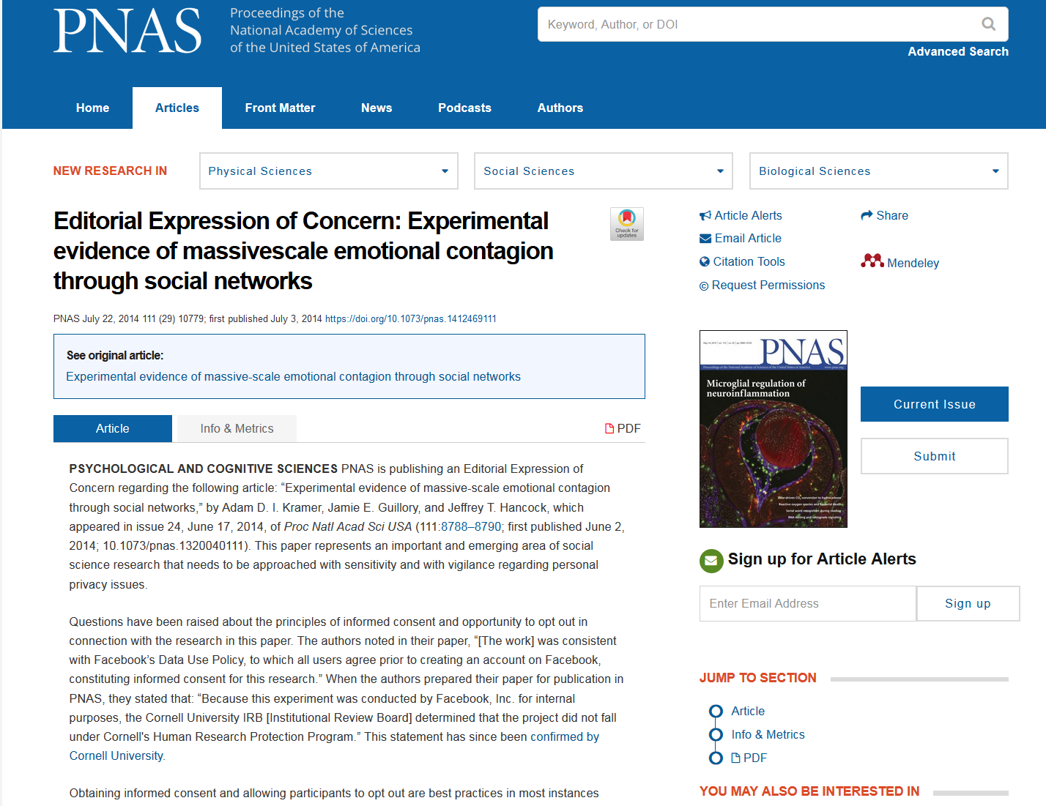
Serious Ethical concerns
“Based on the information provided by the authors, PNAS editors deemed it appropriate to publish the paper. It is nevertheless a matter of concern that the collection of the data by Facebook may have involved practices that were not fully consistent with the principles of obtaining informed consent and allowing participants to opt out.”
Notes:
What FB did was not technically illegal but…..

Slide 8
Round 2 [4 points].
Emotional Robots
Emotions help people decide what is important and make decision-making more complex than purely rational. So it might be useful to try to make a robot that has emotions too (or at least can recognise human emotion). However understanding human emotions is actually very difficult.
Two different robots…..
https://www.youtube.com/watch?v=kWlL4KjIP4M
https://www.youtube.com/watch?v=i8bk39a9xM0
Watch the short clips of the two robots. Which one do you think most people have the most pleasant emotional response to? Why is this important? (2 POINTS)
How would we go about getting robots to perceive human emotions? What do you think are some of the key markers of human emotion that a robot could learn to pick up on? (2 POINTS)

Slide 9
Round 3 [4 points].
TED Talk
Filters, bias and AI
It’s great that algorithms can learn our patterns of behavior and likes and dislikes because it means that our internet searches are tailored for us, our social media newsfeeds are tailored for us and we can rely on AI to do basic tasks – like scanning a whole pile of job applications and picking the one we would like best – right? Well actually, there are some downsides to the application of machine learning to real life contexts.
Can you think of situations where watching a video on YouTube once and then having similar suggestions constantly appear might be a problem? [max 2 POINTS]
Do you think it matters whether different people get different results when they google search the same search terms? Why? Think about divisive issues such as climate change, immigration or gender politics. [ 1 POINT]
In 2018 Amazon scrapped development of an AI algorithm that would learn patterns and words from job applications (CVs) of previous successful software engineer hires and then apply those characteristics to new job applications that they received. What do you think was a major problem here? [1 POINT]

Slide 10

Round 4
Attentional Distraction by reward
You will see a fast stream of images appear. Your job is to identify the one rotated image and indicate whether it is rotated to the left or the right. If there is a bird in the stream then it means that you will receive $1 for every one you get correct! But the bird won’t be rotated so you are better to ignore it.

Slide 11











Get ready. Which way is the image rotated
Notes:
Bird Distractor

Slide 12
Let’s try again. Which way is the image rotated?
Notes:
Bird distractor

Slide 13


OK get ready. Which way is the image rotated?
Notes:
McDonalds

Slide 14
Try again? Which way is the image rotated?
Notes:
McDonalds

Slide 15


Final One. Which way is the image rotated?

Slide 16


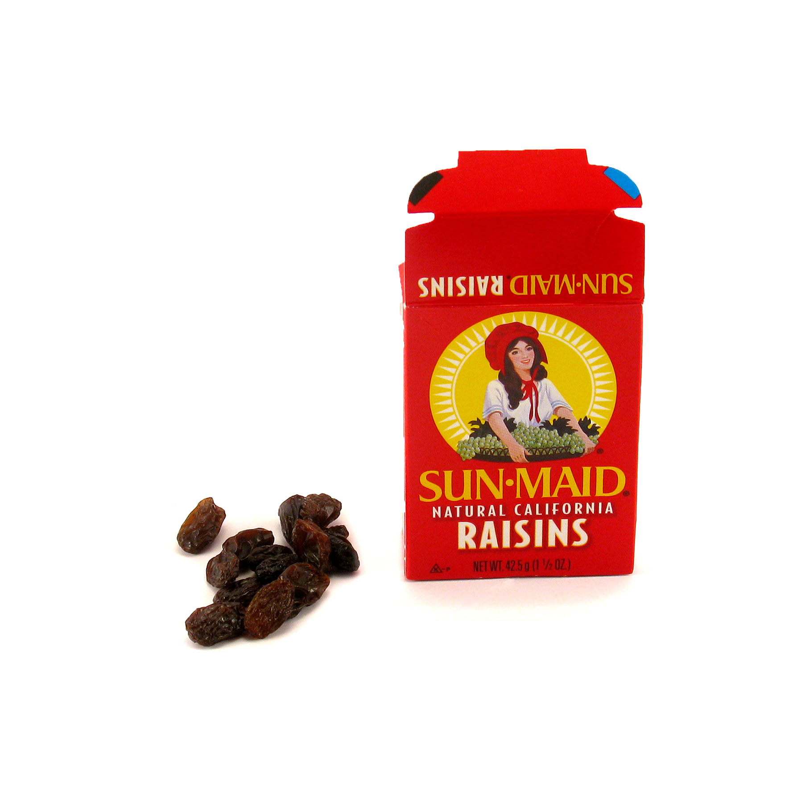


Attentional Distraction by reward
Reward
Neutral
People get more distracted by the images in the ‘reward’ category. Even though these are entirely task irrelevant and even though they are motivated to ignore them.

Slide 17
Round 4 [5 points].
Can you think of a real life example (involving technology) where this sort of attentional distraction by reward happens? (1 POINT)
Why might this be a problem? (2 POINTS)
What do you think would happen if participants in this experiment were offered $100 for good performance? (i.e. correctly identifying the rotated image on most trials)
Perform better
Perform the same
Perform even worse
What do you think would happen if people practiced this task many times?
Perform better
Perform the same
Perform even worse

Slide 18
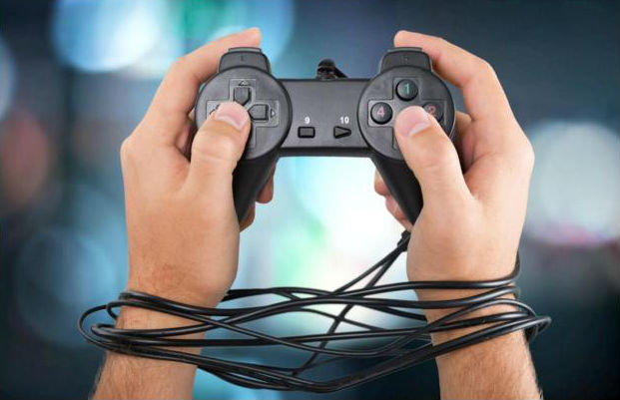
Round 5 [7 points].
Internet gaming disorder is a ‘condition for further study’ in the official handbook of psychological disorders (The Diagnostic and Statistical Manual for mental disorders or DSM). This means that although it is not yet recognized as an official mental disorder, it may well be included in the future alongside alcohol and substance use addiction. Many doctors are pushing for the inclusion of this in the DSM, because they see so many cases of gaming/internet addiction.
Why do you think it is important to have gaming/internet addiction officially recognized in the DSM?
What is one major difference between an addiction such as alcohol or substance use addiction and a gaming/internet addiction?
There are specific criteria in the DSM that are used to identify those who are addicted to gaming versus those who just really enjoy playing but are not addicted. Can you think of what they might be? [max 5 points]
Notes:
ELEVEN CRITERIA
Taking the substance in larger amounts or for longer than you're meant to.
Wanting to cut down or stop using the substance but not managing to.
Spending a lot of time getting, using, or recovering from use of the substance.
Cravings and urges to use the substance.
Not managing to do what you should at work, home, or school because of substance use.
Continuing to use, even when it causes problems in relationships.
Giving up important social, occupational, or recreational activities because of substance use.
Using substances again and again, even when it puts you in danger.
Continuing to use, even when you know you have a physical or psychological problem that could have been caused or made worse by the substance.
Needing more of the substance to get the effect you want (tolerance).
Development of withdrawal symptoms, which can be relieved by taking more of the substance.

Slide 19
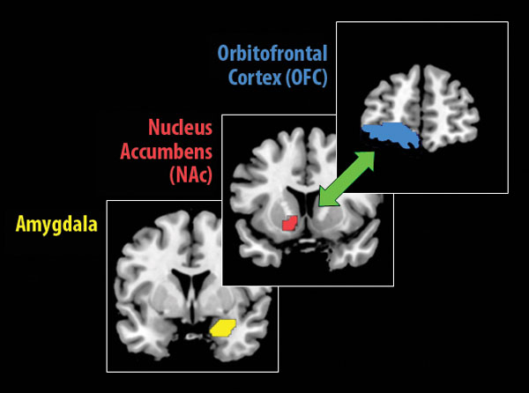
Your brain on games
Making behaviour compulsive
“imagine if the pharmaceutical industry were allowed to operate like the tech companies currently do. Day after day in their laboratories, researchers would cook up amazingly powerful, interesting and potentially lucrative new drugs which they could then launch on an unsuspecting public without any obligation to demonstrate their efficacy or safety. Yet this is exactly what has been happening in tech companies for the past two decades – all kinds of “cool”, engagement-boosting and sometimes addictive services have been cooked up and launched with no obligation to assess their costs and benefits to society”.
Notes:
Classic reward areas light up when you are gaming – as we see with drugs or other rewards.

